Slide 1
Title of presentation
Name & affiliation

Slide 2
Name xxx Role Department University
Date xxx

Slide 4
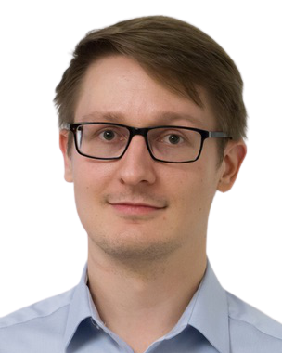
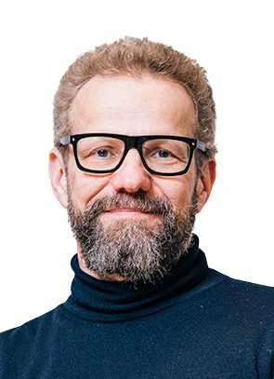
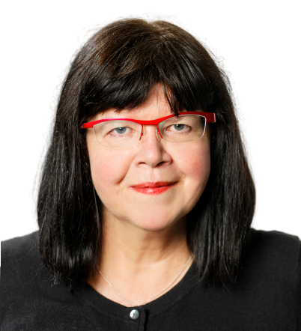
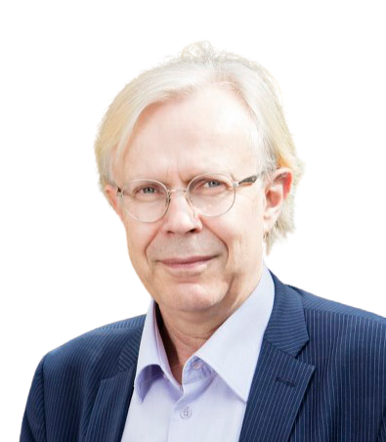
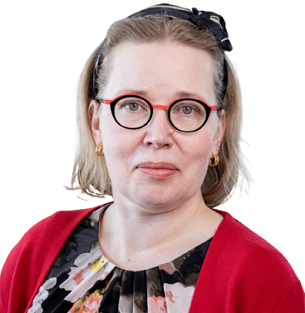
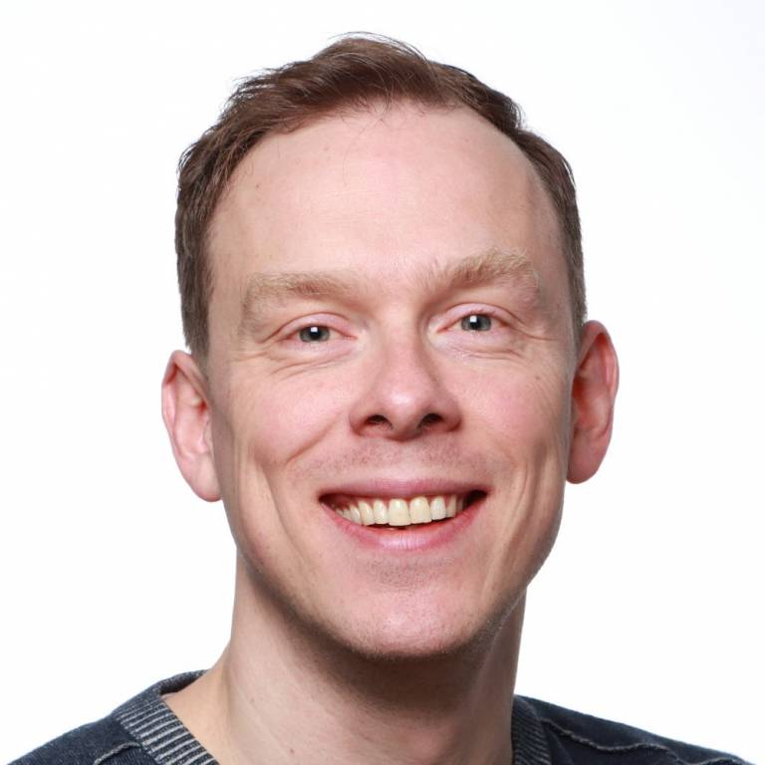
BIOSCIENCE
Jaakko Timonen (Vice-Head)
Active matter
Aalto, PHYS
Markus Linder (Head)
Biomolecular materials
Aalto, CHEM
PHYSICS
Merja Penttilä
Synthetic biology
VTT
Olli Ikkala
Molecular materials
Aalto, PHYS
LIFE-INSPIRED
MATERIALS
Maria Sammalkorpi
Computational modelling
Aalto, CHEM
Arri Priimägi
Soft robotics
Tampere University
CHEMISTRY
Robin Ras
Surfaces and interfaces
Aalto, PHYS
Mauri Kostiainen
Biohybrid materials
Aalto, CHEM

Slide 5
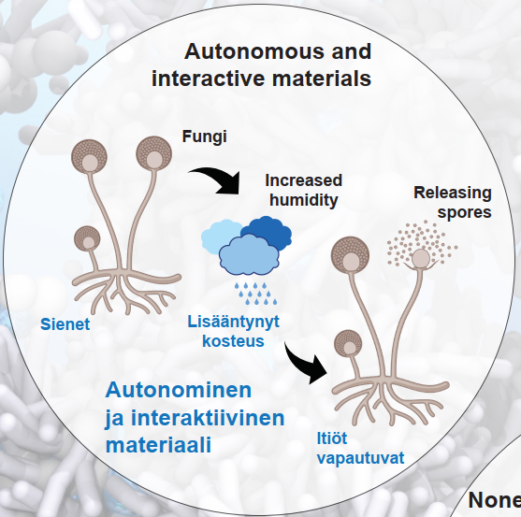
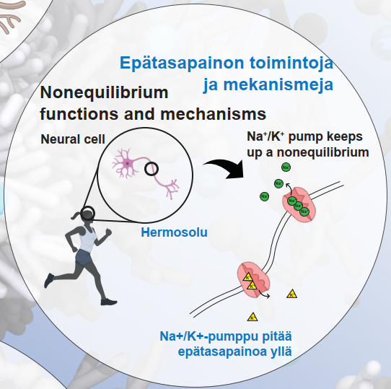
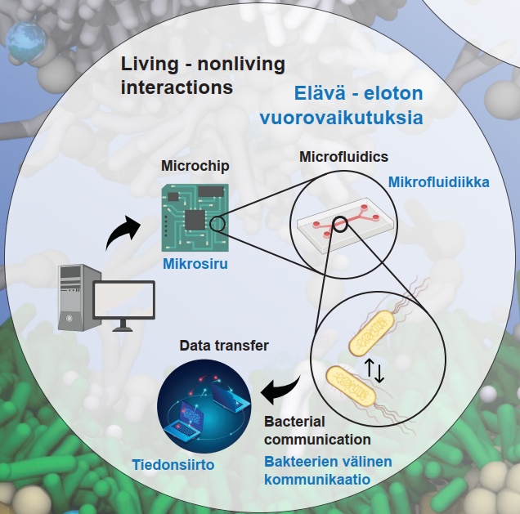
LIBER objectives towards intelligent, adaptive, and active life-like materials

Slide 8
www.libercentre.fi

